Slide 1
Forest Genetics, Tree Seed
Regulations and Planning
and
Climate Based Seed Transfer
Presentation to Coastal Forest Industry
Sept 12, 2018
Margot Spence, RPF Tree Seed Policy Officer
Forest Improvement and Research Management Branch

Slide 2
Forest Genetics, Tree Seed
Regulations and Planning
Overview
Forest Genetic Resource Management
Tree Seed Use Regulations and Standards
Seed Planning and Availability
Notes:
Overview…
But before we explain the activities, rules and planning requirements, let us explain why these are so important

Slide 3

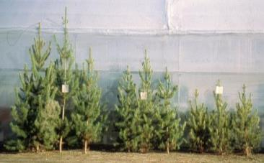
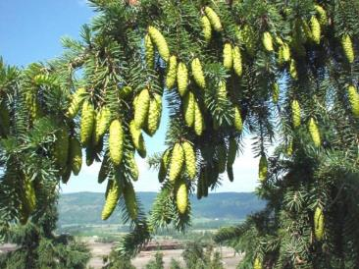
Forest Genetics, Tree Seed
Regulations and Planning
Why do these matter?
Genetic diversity foundation of biodiversity and ecosystem resilience
High genetic diversity within a tree species and between populations
Forest health and productivity
(i.e. future timber supply) depends on genetic source of seed.
1000s of Kg of seed used to grow the 260M seedlings planted annually
Notes:
Why does forest genetics management, seed regulations and planning matter?
Genetic diversity is the foundation of biodiversity and ecosystem resilience. Without genetic diversity, a species or population may not be able to survive, reproduce or adapt to changing biogeoclimatic conditions
Tree species – because they are long-lived species and must endure extreme weather conditions – have high levels of genetic diversity. Not all trees or populations across a species range are the same. Seed from Douglas-fir collected on the south coast won’t grow well in the interior, and vice versa.
The health and productivity of our future forests therefore depends on using the best adapted seed for reforestation.
A lot of seed is also required to grow and plant over 260M seedlings annually. It is therefore important to have structures, policies and systems in place to ensure the best seed is used, and to track seed from its point of collection to its planting site.

Slide 4
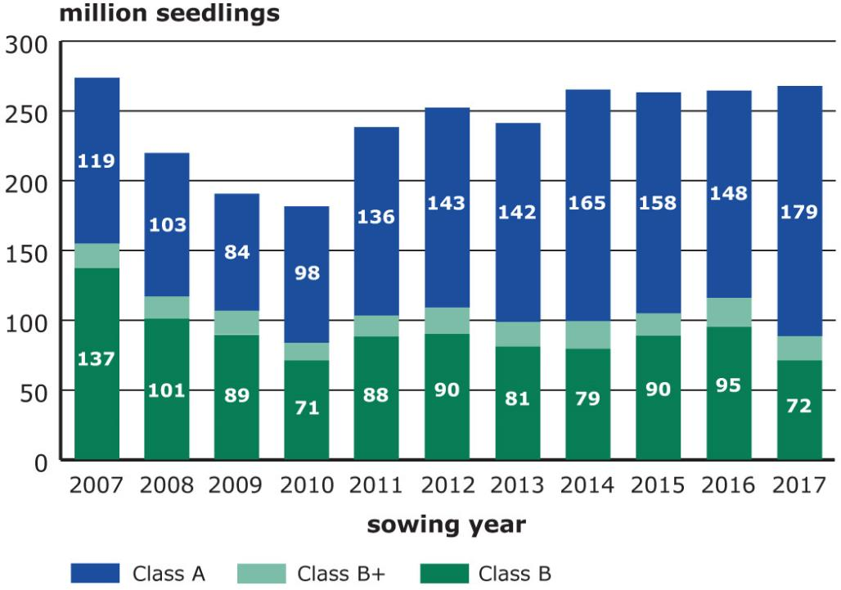
Seedling Requests by Source
Notes:
This is a bar chart with the # of seedling requested by genetic source and year from 2007 to 2017. The total seedlings requested in 2017 was over 268M. Of this 79M or 67% Class A or Orchard Seed. 17M seedlings from Class B+ seed, superiors provenances all Pli – light green. The balance 72M or 27% of the seed used was collected from natural stands.
There will never be enough orchard seed to reforest all of BC, so wild stand collections will remain a vital component of BC reforestation efforts.

Slide 5
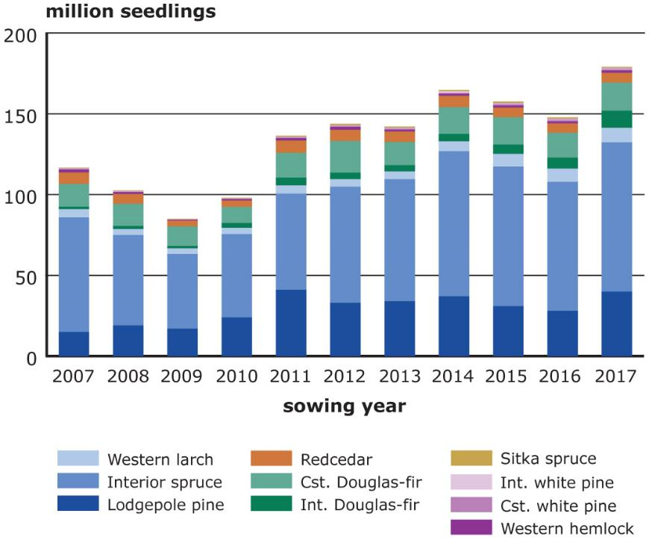
Class A sowing requests by Species

Slide 6
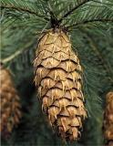
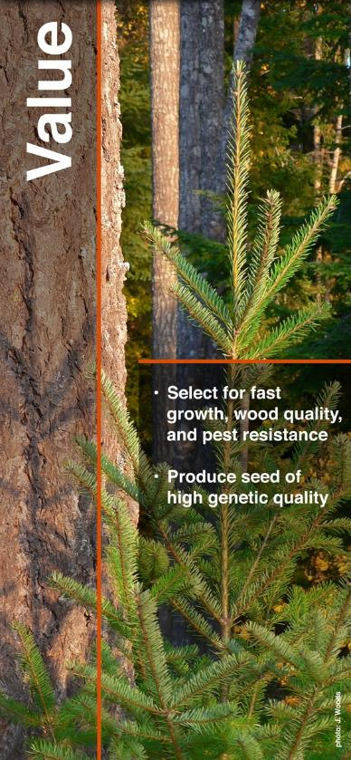
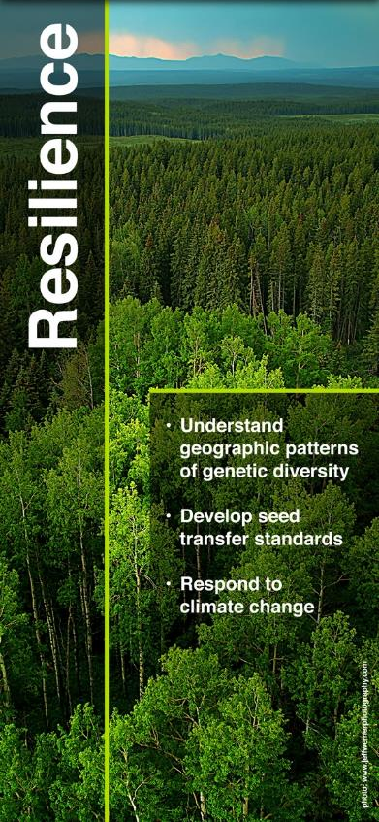
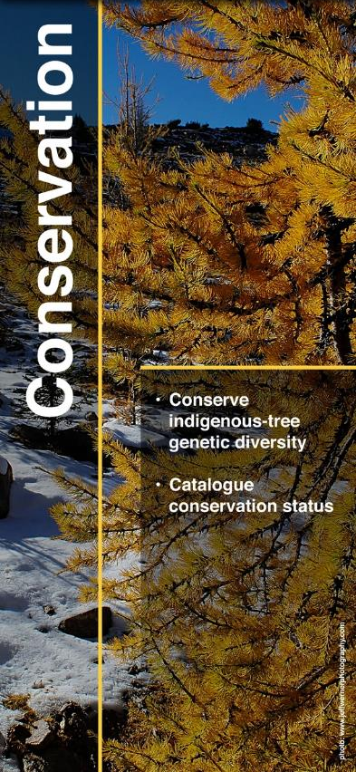
Forest Genetics Resource Mgmt
6
Notes:
Forest Genetics Resource management consists of several activities whose objectives are to enhance the value, resilience and conservation of our future forests.
Activities undertaken to enhance Value including selecting and breeding trees for fast growth, wood quality and pest resistance. Trees selected for these desirable traits, are established in seed orchards to produce high quality seed for reforestation.
Activities under Resilience include research to understand the geographic patterns of genetic diversity within a trees species. Data from extensive provenance-based field tests are used to establish seed transfer standards – which limit how far seed/seedlings can be moved from its point of collection to a planting site. This research is also used to develop adaptive responses to climate change, which will be covered in greater detail later.
Conservation activities include measuring, monitoring and cataloguing of the genetic diversity of BC’s indigenous tree species. Representative populations conserved in in situ reserves such as protected area, and seed collections (ex situ).
Many agencies and people are involved in these activities, most of which are coordinated under the auspices of the Forest Genetics Council of BC

Slide 7
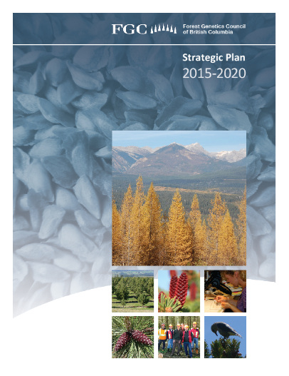
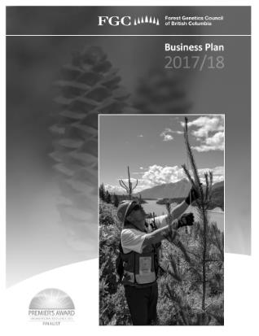
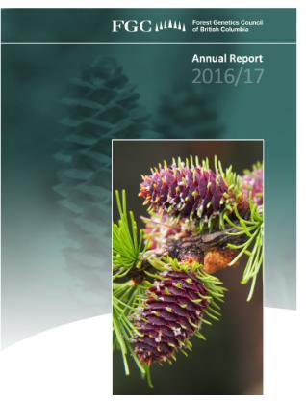
  Appointed by Provincial Chief Forester
  Develop Strategies, Goals, and Plans
  Provide Advice and Coordinates Activities
  Supported by Technical Advisory Committees
Notes:
The FGC is an advisory stakeholder body appointed by the CF with representation from govt, industry and academia.
FGC’s mandate is to develop strategies, goals and business plans, species plans – which will be highlighted later - and provide advise to the Ministry. It is supported by several TACs.

Slide 8
















FGC Partners
Notes:
Here is a snap shot of the diversity of organizations involved in FGC and its TACs.
These partners have different roles and responsibilities in managing BC forest genetics resources

Slide 9
Roles and Responsibilities
Ministry of Forests… Forest Improvement and Research Management Branch (FIRM) | Licensees/BCTS | Academia
Research | Harvesting | Research
Tree Breeding | Silviculture | Education
Seed Orchards | Seed Planning | (Climate modelling)
Policy and Planning | Seed Orchards | (In situ catalogue)
Tree Seed Centre | Reporting
Information Systems
Region/Districts | Private Companies
Authorizations | Seed Orchards | Cone collections
Silviculture | Seedling Nurseries | Stock Coordination
Compliance and Enforcement | Field test measurement and maintenance | Planting
Notes:
The majority of the forest genetics related activities and services are led or provided by Forest Improvement and Research Management Branch. These activites include Genetics Research, tree breeding (e.g. Greg, Nick, Michael, JR…), seed orchards (Stephen, 5 sites – Saanich, Vernon (2), Salmon Arm and PG), policy and planning (Margot, Susan & Leslie), Tree Seed Centre (Dave et al) and Info Systems such as SPAR
Regions/district are responsible for issuing authorizations, undertaking silviculture – FFT – and C&E
….

Slide 10

Tree Seed Regulations and Standards
Forest and Range Practices Act (FRPA)
  Forest Planning and Practices Regulation
  Woodlot Licence Planning and Practices Regulation
    Chief Forester’s Standards for Seed Use
Notes:
The development of tree seed regs and standards is led by FIRM’s policy group. The majority of these rules are science-based
Tree seed collection and use rules are described in the following legislation, regulations and policies:
FRPA
FPPR and WLPPR,
CF Standards for Seed Use.

Slide 11
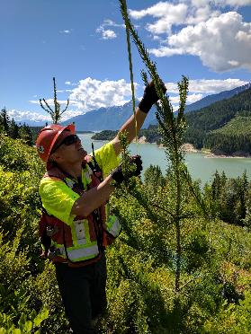
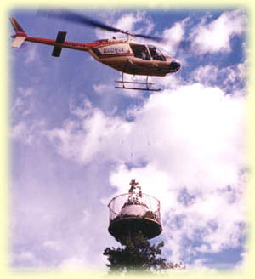
Forest and Range Practices Act
Seed
31 A person required to establish a free growing stand must ensure that seed used for that purpose conforms to prescribed requirements.
Rule of Law not Professional Reliance
Unauthorized timber harvesting
52 A person must not cut, damage or destroy Crown timber unless authorized under the Acts or by the minister for silviculture … or other purpose.
Photo: Fandrich cone harvesters
Notes:
FPRA includes several references to tree seed.
The first and most important is s 31, which obligates persons planting trees to establish a free growing stand to use tree seed in accordance with the prescribed requirements. We will explain these requirements shortly
Another important and relevant section in FPRA, is s. 52.

Slide 12
Forest and Range Practices Act
52.1 Minister may require, comments by interested parties, impose conditions, and request security.
Providing a “Section 52.1 authorization” is delegated to the District Manager
Interpretation of requirements:
  Required for any cutting (or ‘raking’) of branches or tops of standing timber by means of climbing or helicopter
  Not required for picking cones from live branches, felled timber or squirrel caches.
Photo: Fandrich cone harvesters
Notes:
FPRA includes several references to tree seed.
The first and most important is s 31, which obligates persons planting trees to establish a free growing stand to use tree seed in accordance with the prescribed requirements. We will explain these requirements shortly
Another important and relevant section in FPRA, is s. 52.

Slide 13
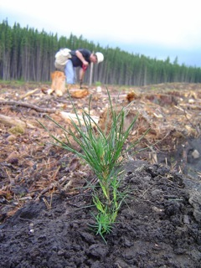
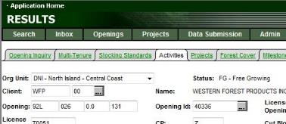
Forest Planning and Practices Regulation*
Use of seed
43 Chief Forester authorized to establish
seed use standards
Persons planting trees must follow seed standards unless alternative approved.
Persons must keep records of seed used.
Silviculture treatment records
86(3)c Persons must report pertinent information about seeds used to reforest a cutblock (e.g. seedlot #)
* Woodlot Licensee Planning and Practices Regulation s. 32 Use of Seed; s.76 Annual Report
Notes:
The FPPR and its equivalent, the WLPPR, provide the authority for the CF to establish standards governing the collection, registration, storage, selection and use of tree seed.
Persons with reforestation obligations – licensees, and BC Timber sales managers - are obligated follow these standards, unless an alternative consistent with the intent of the standards is submitted and approved by the CF or her delegate.
The regulation also requires persons to keep track of the seedlots used and the locations planted, and report these to the ministry through RESULTS.
The Woodlot Licence Planning and Practices Regulation has parallel requirements

Slide 14
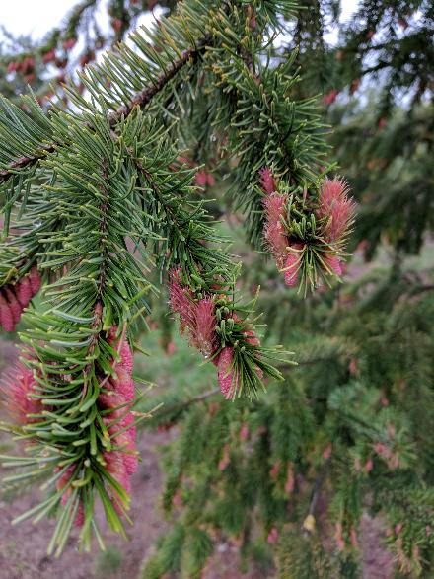
Chief Forester’s Standards for Seed Use
Purpose:
  To maintain the identity, adaptability, diversity and productivity of the Province’s tree gene resources
Contents:
  Registration
  Storage and Testing
  Selection and Use
  Seed Transfer

Slide 15
1. Registration Standards – Natural Stands
Application form submitted to Ministry (on-line via SPAR)
  Lat/long/elevation/BEC unit (Map now required)
  Collection dates & methods
  Collectors name & contact information
  Seed must be:
  collected from ≥ 10 trees
  collected from same BEC variant, within 8km radius
  not collected from a plantation
  shipped to Tree Seed Centre
  labelled with # inside and outside of sacs
  ≥ 97% pure seed, between 4% and 9.9% moisture
  content
Ministry assigns seedlot #s
  Class A - Seed Orchard
  Class B+ - Superior Provenance
  Class B - Natural Stand

Slide 16
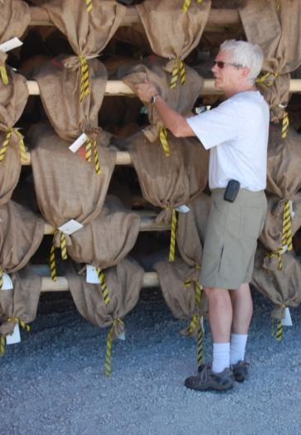
2. Storage and Testing Standards
Maintain identity and integrity of lot during collection and interim storage (keep accurate records)
Store seed at the Tree Seed Centre
TSC tests seed for purity, moisture content and germination
Withdrawal requests in writing to
TSC or through SPAR
No fees* for registration, storage, testing or withdrawal
*with some exceptions.
Notes:
Exceptions for private land, extra testing, stratificaiton

Slide 17
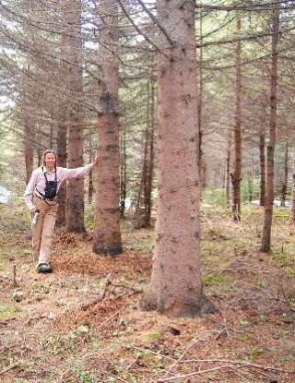
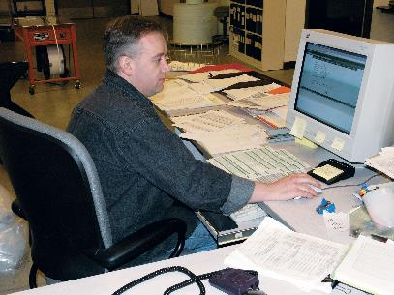
3. Selection and Use Standards
Persons must use seed with GW ≥ 5% (for the species and trait that best achieves the forest management objectives for the stand) if available….
  Genetic worth (GW) = % improvement for trait compared to natural stand seed
    GVO+20 = 20% more volume at rotation
    DSB+50 = 50% resistant to white pine blister rust
‘Available’ if…
  you own it or it is identified as surplus on SPAR
  of sufficient quantity for request
  complies with the seed transfer limits
  fair price

Slide 18
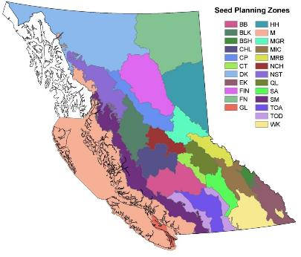
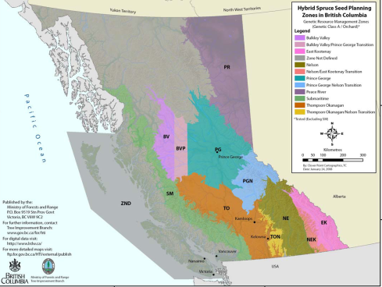
4. Seed Transfer Standards
Geographically-based seed transfer (GBST)
Natural Stand seedlots
  Seed Planning Zones (SPZs)
  Lat/Long and Elev limits
  BEC zone
Seed orchard seedlots
  Seed Planning Units (SPZs and elevation limits)
  Latitude limits for coastal species
Notes:
Furthermore, 95% of seedlings planted by a licensee (one licence) or BCTS timber sales manager (mgmt. unit) must comply with the transfer standards

Slide 19
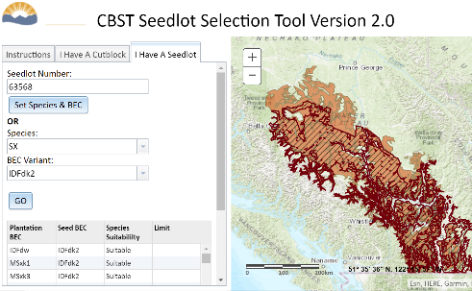
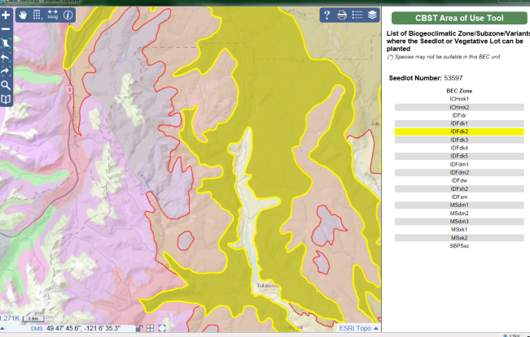
4. Seed Transfer Standards
Climate-based seed transfer (CBST)
BEC variant mapping in SPAR
Notes:
Furthermore, 95% of seedlings planted by a licensee (one licence) or BCTS timber sales manager (mgmt. unit) must comply with the transfer standards

Slide 20
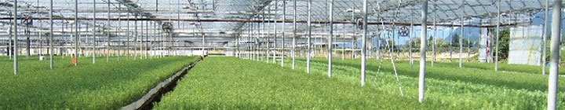
Seed Planning & Availability
Determine seed/seedling needs
(by BEC variant of planting sites)
Identify BEC variants from which seed can be procured and suitable seedlots in SPAR (or by SPU)
Review FGC Species Plans for seed orchard coverage and availability
Contact seed owners and
seed producers to purchase seed
Collect if insufficient seed available
Notes:
The first step in planning is to determined the # or seedlings, and subsequently the amount of seed required to grow those seedlings for a species for a period of time (1-5 yrs). Don will cover how to calc in the pm
The next step is to match your operating areas with seed planning zones and transfer standards, We have some examples of zonal maps in the next couple of slides. You can use SPAR/SeedMap (pictured) to do this – Susan will show you how. She will also show you how to identify suitable seedlots in SPAR.
Even if there is no suitable seed for a major commercial species, best to check FGC’s species plans to see if there are orchards producing seed for the area. If so, contact. Only if there is gaps of seed identified should you proceed with planning and investing in cone collection.

Slide 21
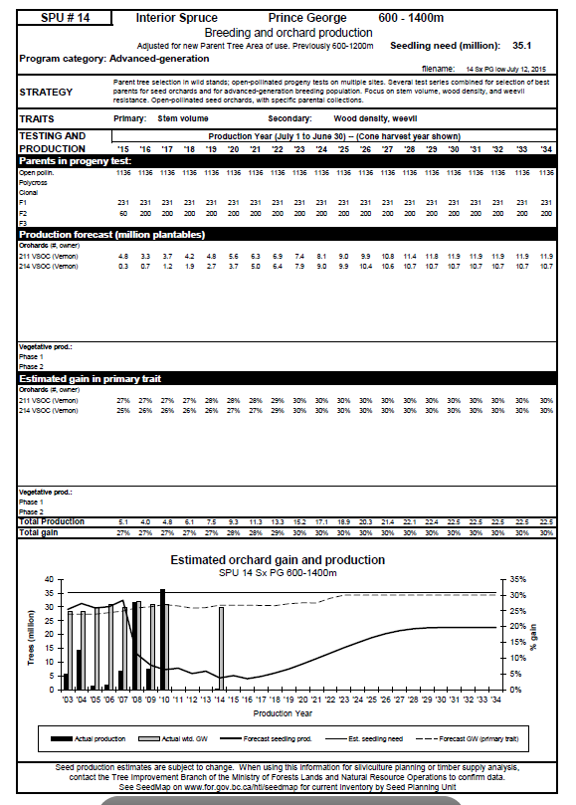
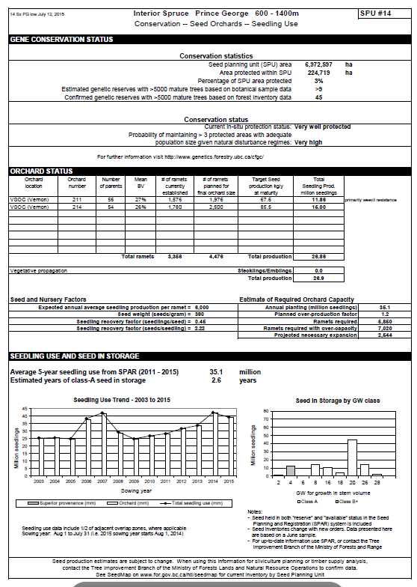
FGC Species Plans
2017/18 FGC Business Plan, Appendix 3
http://www.fgcouncil.bc.ca/doc-04-speciesplans.html
Notes:
This is an example of a Species Plans. FGC annual business report contains pages like this for each commercial tree species and seed planning unit (show a copy of FGC business plan). ) These plans are also available on-line.
These plans contain status of the breeding programs and orchards established for each SPU. They also show the amount of seed produced and used over the past decade, and the amount of Class A seed in inventory (as of Aug 2017). Inventories change constantly, so best to check the latest inventory status on SPAR and the seed orchard managers
Example on slide Sx PG LOW (600-1400m)

Slide 22
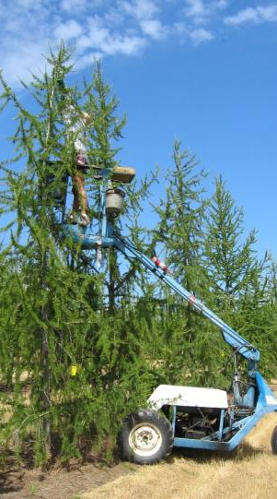
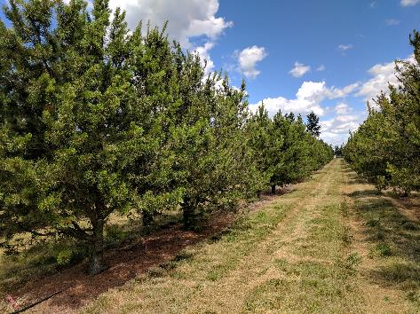
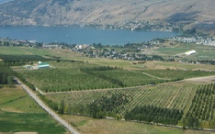
Seed Orchards
100 seed orchards in BC
Managed by Ministry, private companies and SelectSeed
12 conifer species, plus alder & birch
Yellow cypress cuttings hedges
An orchard contains 20-50 parents
Notes:
There are approx. 100 seed orchards in the Province located on 14 sites managed by govt and the private sector in BC.
The species represented in orchards include the main 12 commercial conifers plus alder and paper birch. Hedges are also maintained for yellow cedar to produce cuttings from selected parents.
Each orchard contains at 20-50 parents, to maintain high levels of genetic diversity in the seed produced.

Slide 23
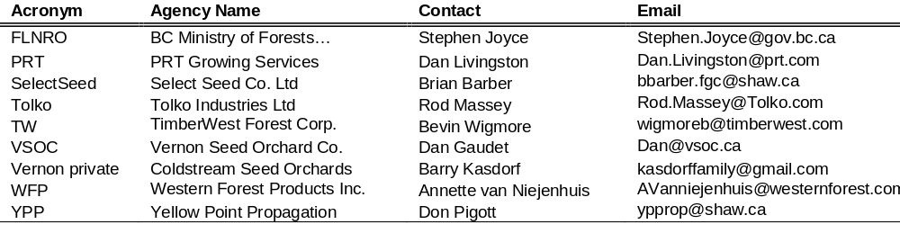
Orchard Seed Contacts
Also included in 2017/18 FGC Business Plan, Appendix 3
http://www.fgcouncil.bc.ca/doc-03-businessplans.html
Notes:
The FGC business plan also list the names and emails for orchard managers…

Slide 24
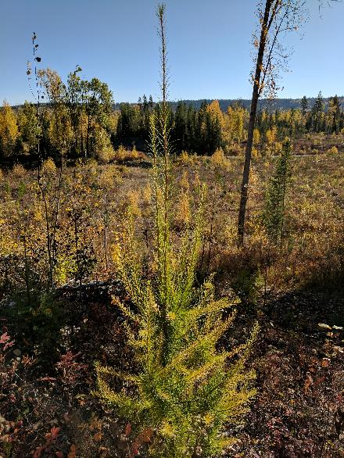
Summary
Forest Genetics, Tree Seed
Regulations and Planning
Seed matters
Know and abide by the regulations and standards
Determine if suitable seed is
available before investing
in a collection

Slide 25
Introduction to
Climate Based Seed Transfer (CBST)
Notes:
SPEAKING NOTES:
CBST was specifically designed to adapt to and mitigate climate change.

Slide 26
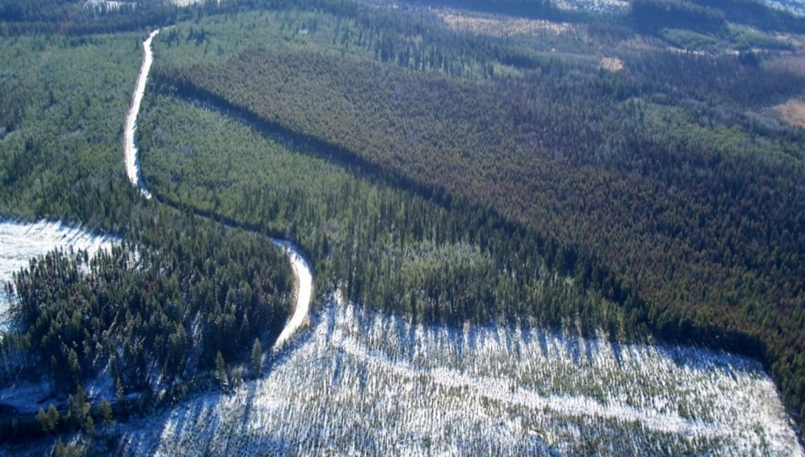
What is Climate Based Seed Transfer (CBST)?
“Climate Based Seed Transfer (CBST) refers to a seed transfer system based on climate, for the purposes of adapting to and mitigating the impacts of climate change.”
Notes:
SPEAKING NOTES:
CBST was specifically designed to adapt to and mitigate climate change.

Slide 27
Both systems are science based and supported by data from provenance trials
How does CBST compare with BC’s most recent approach to seed transfer (geographically based seed transfer)?
GBST
A geographically-based methodology using, longitude, latitude, elevation and biogeoclimatic zone,
CBST
A climate-based methodology that matches the climate of the seed source with the current and (near) future climate of a planting site.
Based on new and emerging climate and forest genetic science.
Includes “assisted migration.”
Notes:
SPEAKING NOTES:
Read slide and add:
Assisted migration is a strategy to deal with climate change
BC has a good based of provenance trials which has helped BC move forward on CBST – applying SPACE for TIME to see which climates are coming our direction

Slide 28
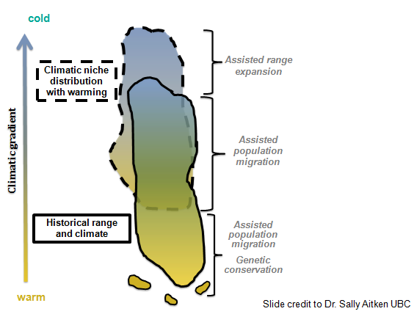
“Assisted Migration”
(1) is a climate change adaptation strategy;
(2) is the intentional movement of tree seed, from areas they grow naturally, to planting sites that are climatically suitable for their growth at the present time and in the near future.
Notes:
SPEAKING NOTES:
The term “Assisted Migration” is more commonly used for intentional movement of SPECIES outside their historical range
Due to our forestry framework in BC, we pick a species first using STOCKING STANDARDS and then select a seed source.
Therefore until stocking standards are revised using assisted migration, species will not move our of their historic ranges with CBST.
CBST operates in the area on the diagram identified as “assisted population migration”

Slide 29
CBST Science Foundation
Based on climate and forest genetic (provenance) data
Climate represented by BEC variants
CBST accounts for both past (adaptation lag ~70years) and future climate change (15yrs coast; 20yrs interior)
= Climate migration distance is to the first quarter rotation
Baseline data sets
  BEC10
  ClimateBC
  Transfer functions
  Minimum genetic and species suitability thresholds
  Expert opinion
For more information, see Technical Report 099: “A Proposed Climate-based Seed Transfer System for British Columbia” by G O’Neill, T Wang, N Ukrainetz, L Charleson, L McAuley, A Yanchuk and S Zedel. (2017)
Notes:
SPEAKING NOTES:
The actual transfer distances under CBST are based on a Science Foundation that uses climate and provenance data
the Science behind CBST was led by Dr Greg ONeil and published in 2017 as noted at the bottom of the slide.
Climate is represented by BEC variants – BEC variants were specifically selected to represent climate AND provide operational alignment
There are 8 climate variables plus latitude that are matched
CBST accounts for past climate change (from the 1940s til now – “adaptation lag”) AND projects climate change into the future (15/20yrs, coast/interior)
This is considered a very conservative approach, with most of the migration distance making up for PAST climate change.

Slide 30
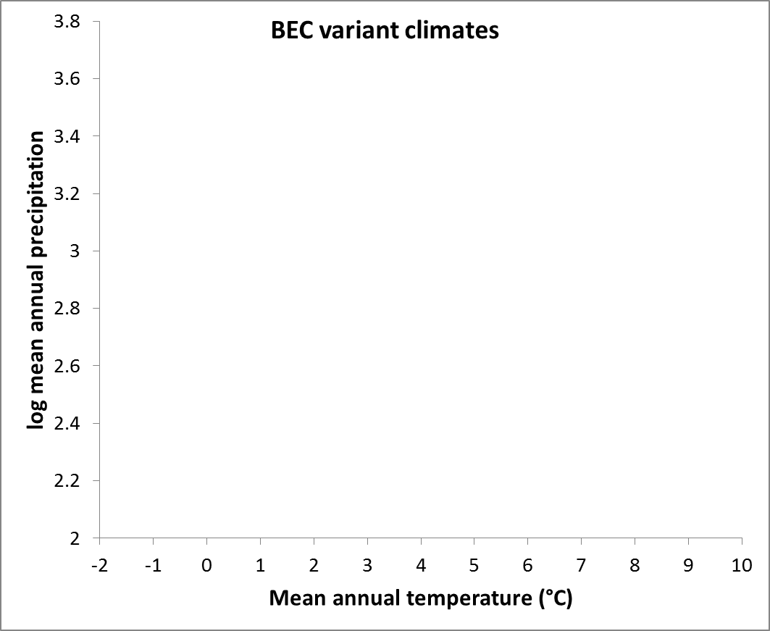

Migrating the climate space
(BEC variants represent climate space)
BEC units
Seed deployment space
Seedlot
Notes:
SPEAKING NOTES
This slide is from Dr Greg O’Neill
Each point represents a BEC variant – defined by MAP and MAT
The upper right of the graph represents the warm, wet, coast and the bottom left the cold dry interior
So under CBST the climate space associated with the seedlot (and BEC variant ) indicated , moves from the warmer wetter BEC to the cooler drier BEC – and all the BEC variants shown in the circle have a similar enough climate to be included in the new deployment area.
Notice the two arrows which represent the migration distance – the longer one is the distance to account for adaptation lag and the shorter one accounts for the future projection of climate change (to ¼ Rotation).
Note that this slide uses two climate variables (MAT and MAP) to demonstrate the migration of the climate space using BEC variants
CBST uses 8 climate variables plus latitude, so in reality it is a 3-Dimensional space that we are migrating.
For reference from Greg: Transfer functions determine how big the oval is for each species. Matching BEC var climates is based on the RELATIVE position of each BEC to the others (this graph actually uses 1975 climate data, as the midpoint between 1961 and 1990 (a common dataset), which represents climate change from 1945 to 2016). So the Data does not reflect avg temps or precip on the ground now or in the future.

Slide 31
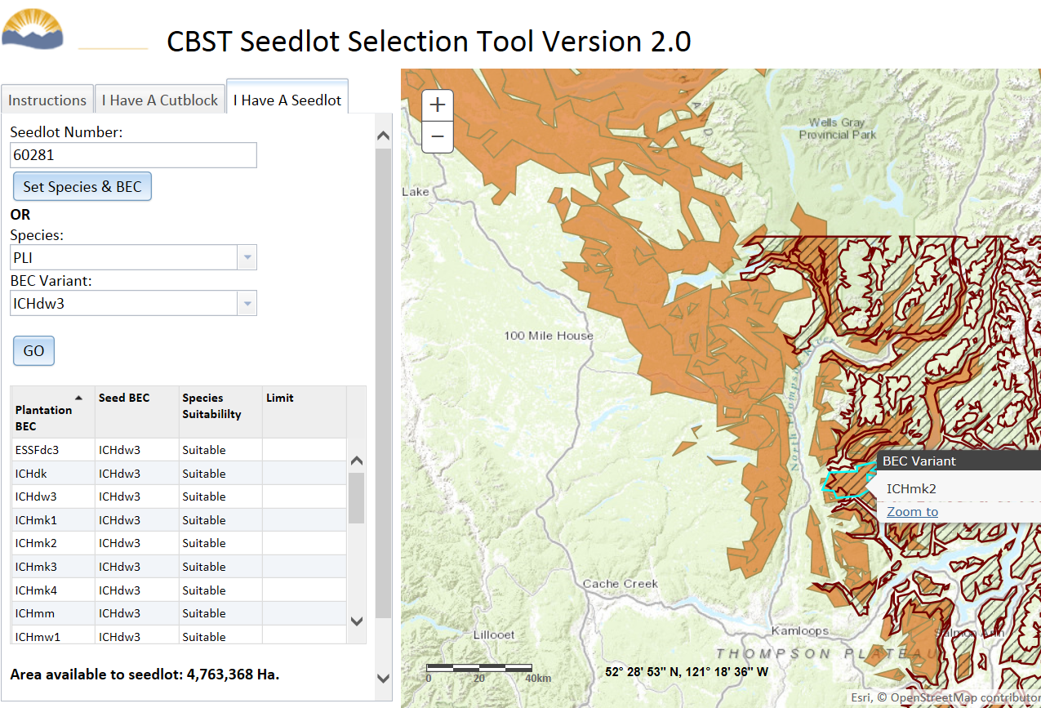
Example of Shift to a Seedlot Area of Use
Current seed deployment area
Current Area of Use
CBST seed deployment area
CBST Area of Use
The CBST seed deployment area (i.e. CBST Area of Use) comprises the orange areas marked on the map. The current seed deployment area (or Area of Use) is marked in the brick red colour.
Notes:
SPEAKING NOTES:
This is an example of a shift to a seedlot area of use, using the CBST Seedlot Selection Tool.
The tool has two perspectives:
I have a seedlot – when you are wanting to know where you can deploy or plant it, and
I have a cutblock – when you are wanting to know what seedlots you can plant on a particular site.
This slide is showing the “I have a seedlot” mode, for Seedlots 60281 (which is a Pli from the ICH dw3)
The red hatch is the deployment area for this seedlot under the “Geographically based seed transfer” standards, and the orange area is the CBST deployment area.
Interesting to note the latitude line on the old area of use – which is a little sharp cut off for a biological, climate and geographic based system – BEC variants do follow more natural boundaries and should make some sense on the ground.
In general you should note that plantability of this seedlot is moving to slightly colder temperatures (eg north and higher elevations) as expected.

Slide 32
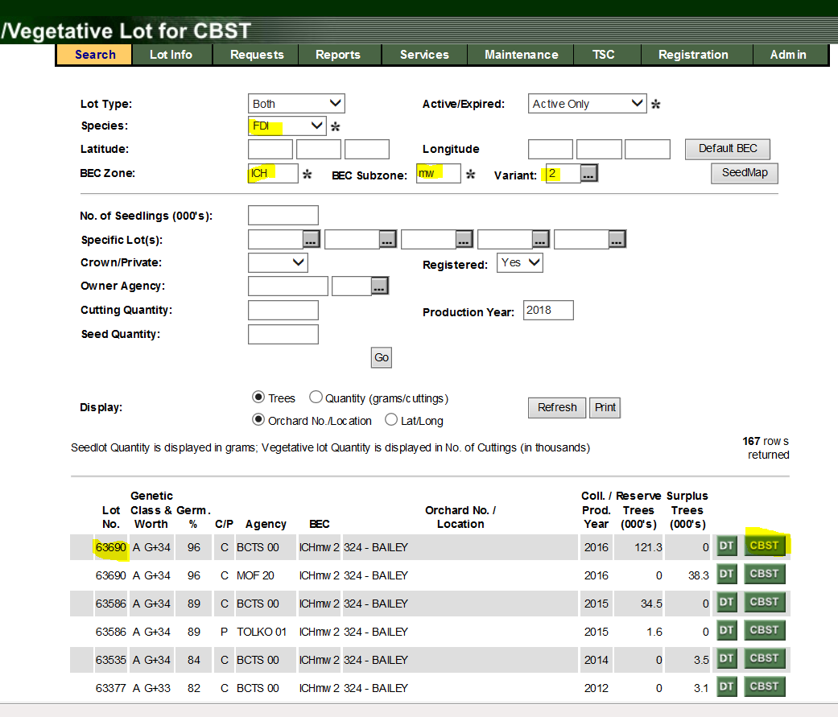
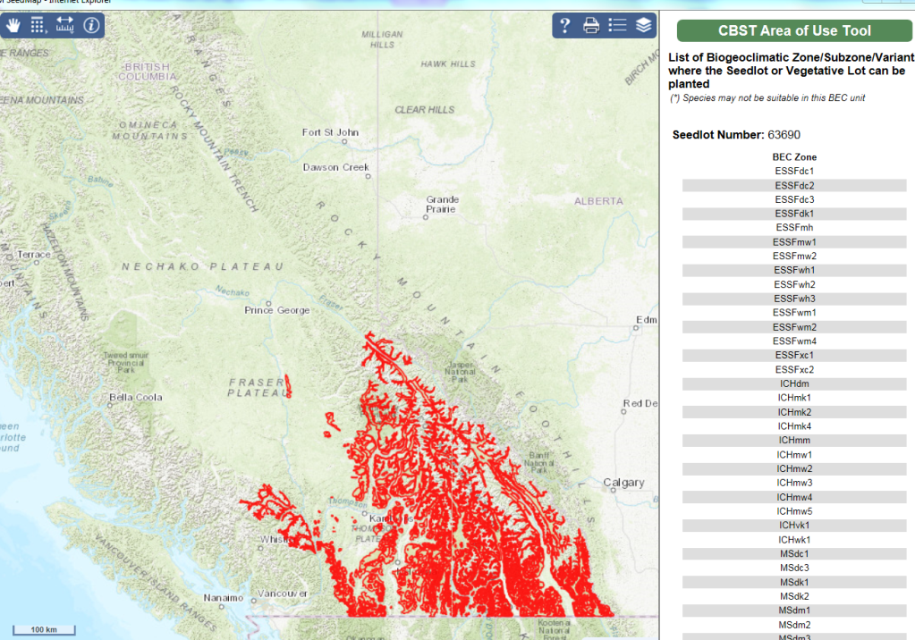
The CBST Seedlot Selection Tool enabled mapping of shifts in seed deployment and procurement areas under CBST
Functionality and data now incorporated into SPAR – training to begin in August, for 2019 Seedling Requests
Notes:
SPEAKING NOTES:
Read off slide
Can mention that Forsite developed the tool if you want.
SPAR screens shown are for seedlot 63690 - Fdc seed from the ICHmv2.

Slide 33
Chief Forester’s Standards for Seed Use
Amendments of April 5, 2018 come into effect August 6, 2018¹
Introduction of:
Option to use CBST standards, continue with Geographically Based Seed Transfer standards (GBST) or use a mix of both
New cone collection requirements that align with CBST
Other minor amendments to update reference and administrative provisions
https://www2.gov.bc.ca/gov/content/industry/forestry/managing-our-forest-resources/tree-seed/legislation-standards/chief-forester-s-standards-for-seed-use
¹Notice period may be waived
Notes:
SPEAKING NOTES:
As of April 5, 2018, the Chief Foresters Standards for Seed Use have been amended to enable CBST.
These changes come into effect as of August 6, 2018, although the notice period may be waived.
There are two main changes in the amended standards:
The standards now provide the OPTION to use CBST . You can still continue with GBST standards, or you can try a mix of both.
The second change is that natural stand cone collection requirements have been changes to align with CBST – and we will talk more about this shortly.

Slide 34
CBST Policy Timeline
Geographically Based Seed Transfer standards
I Science Foundation
2008 - 2016
Adaptive Science
II Policy Development
Early Implementation through Alternatives Process
Sept 1, 2017 – August 6, 2018
III SPAR Revisions
Transition Period
III CBST standards operational
Amendment to Standards - Effective Date
August 6, 2018
IV Monitoring and Revision
2016
2017
2018
2019
2020?
NOW
Notes:
SPEAKING NOTES:
The purpose of this slide is to point out that there is a Transition Period when both the GBST and CBST Standards are acceptable.
We currently expect about a two year transition period – as directed by the Chief Forester – before the option to use the GBST standards will be removed.
This is subject to our impact assessment and gap analysis work, so the transition could be a bit longer if we discover issues that need more time to resolve.

Slide 35
The Transition Period
Transition Period
Time to learn the new CBST system – the GBST standards will be removed as an option at end of transition period
Opportunity to use up seed that may not be useable under CBST
Current thinking is a 2 year transition
  subject to broader stakeholder consultation and results of the impact assessment and gap analysis
Notes:
SPEAKING NOTES:
The purpose of the transition period is to allow time for seed users to learn the new system, and to provide an opportunity to use up seed you own that may not be useable under CBST,
or you may need to establish buying and selling arrangements for your seed.
As mentioned our current thinking is for a 2 year transition period, subject to impact assessment and gap analysis.
We also plan to undertake some broader stakeholder consultation (possibly an on-line survey in fall 2018) to help determine the length of the transition period.

Slide 36
Strategic Use of Policy Options in Transition Period
Transition Period
If the goal is to maximize productivity of a site, use policy options is this order of priority:
  Use CBST seed transfer and Class A seed with the highest Genetic Gain
  Use Current transfer standards with Class A seed with the highest Genetic gain
  Use CBST seed transfer and Class B seed
  Use Current transfer standards and Class B seed
If none of these policy options have seed availability –
consult with FIRM.
Notes:
SPEAKING NOTES:
Read slide
Notice that you can trade off GW for adaptation – but this is at the expense of some productivity
Policy on GW impacts has not yet been discussed by the Policy working group and stakeholders advisory group
However, in general we want to save our expensive A class seed for productivity gains, given that we have an effective approach to adaptation in CBST.

Slide 37
Risks related to Introduction of CBST
Doing nothing about climate change is high risk
  Losses from increased wildfire and pests
  Loss of productivity through maladaptation
Using CBST mitigates the impacts of climate change and reduces risk
  We are currently planting into sites that are too warm for the seed
  With CBST, we will be planting into sites that are slightly colder (in anticipation of ongoing climate change)
  CBST takes a conservative approach - focusing more on catching up with climate change to date, rather than projecting too far into the future
Notes:
SPEAKING NOTES:
Before we move on to talk about the Cone Collection Standards, just a few words about Risk
We have had quite a few questions and discussions about the risk of introducing a new seed transfer system for climate change – given the level of uncertainty around climate change
Read slide

Slide 38
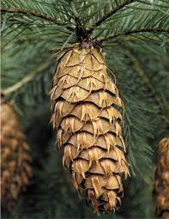
Revised Cone Collection Standards
New requirements came into effect August 6, 2018 with no transition period.
Seed now required to be collected from a single BEC variant (and seed collection area to be mapped in SPAR).
Why new collection standards?
To maintain identity of seed source for future transfer limits
To create a “CBST area of use” (based on BEC variants)
To reduce the likelihood of increasing inventories that can not be used after the CBST transition period.
Notes:
SPEAKING NOTES:
Emphasize that there is no transition period for the change to cone collection standards
The CBST Stakeholder Advisory Group and Policy Working Group both felt we should start collection cone under CBST transfer standards as soon as possible, and STOP collecting seed that only has a potential two year use period (eg during the transition period).
Read off the “Why new collection standards?” bullets
Could add that maintaining the identity of the seed source is specifically required under FRPA, and important given the expected ongoing climate change and potential for changes to seed transfer

Slide 39
Revised Cone Collection Standards
No change to requirement to collect from a minimum of 10 trees and area with a maximum 8 km radius.
No longer need to consider elevation.*
May collect from one or more seed planning zones - unless you wish to maintain the option to use GBST in the transition period, then collect from a single BEC unit and the same natural stand seed planning zone.
*See Cone Collection and Climate Based Seed Transfer Information Bulletin - May 2018
Notes:
SPEAKING NOTES:
I recommend you pick up a copy of the Cone Collection and Climate Based Seed Transfer Information Bulletin (copies provided), which go into further detail about the amendments
Read bullets

Slide 40
CBST Impact Assessment and Gap Analysis
To what degree does CBST impact seed use, investments, and assets, including impacts to:
  Seed Users
  Seed Owners; and
  Seed Producers?
How are CBST impacts characterized compared to previous deployability of a seed lot (losses, gains)?
What are the opportunities (e.g. new seed sources moving in)?
Where are the gaps in CBST coverage? What are the opportunities to fill them (in short and long term)?
What do we do about “orphans”? Seedlots with no where to plant, or BEC variants with no seed source?
Notes:
SPEAKING NOTES:
Part of the policy framework for CBST is to undertake assessment and provide tools so that each of the groups listed here, can assess their own situation.
The assessment will look at how seed deployment is moving, what gaps in coverage are created, if and where the opportunities might be (eg to use Class A seed where it has not been available before)
Also the policy group still needs to discuss how we address the situation where we no longer have any seed availability or any area to deploy existing seedlots.

Slide 41
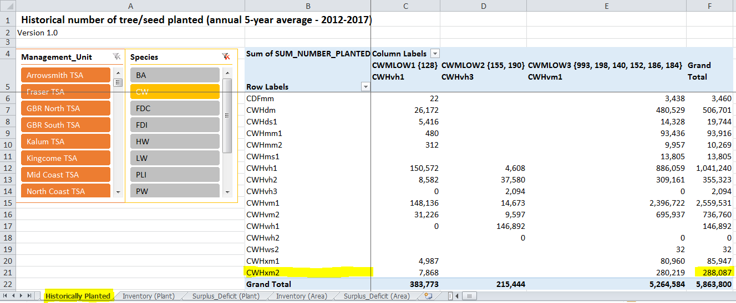
Gap Analysis – Cw Historical Planting
Historical Planting (trees) of Class A seed - by BEC variant based on an annual Five Year Average Source: RESULTS
Notes:
SPEAKING NOTES:
So I’m going to walk you through one of the assessment tools we have created – and I recommend you pull out the supply and demand summary sheet provided to look at, at the same time.
This first slide shows the Historical planting of Cw in BC - shown by BEC variant (rows) – for each seed BEC variant (columns) (also represented by a group of orchards – listed in column header)
The seed BEC variants (or groups of orchards) are the same as are used on the supply and demand summary sheet, where we have called them “Interim CBST SPUs”.
Note this currently provides data on A class plantings although we are working on adding the B class.

Slide 42
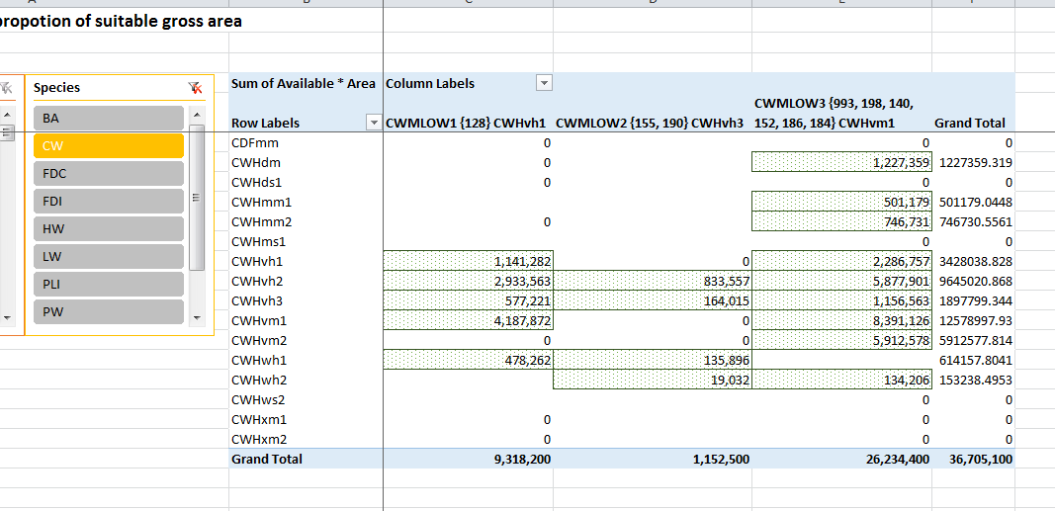
Gap Analysis – Cw Class A Inventory in SPAR
Inventory is based on seed currently in the bank (potential trees) - proportioned to BEC variants (based on the proportion of each BEC var to the gross seed deployment area (CBST AOU) for the Sp BECvar combination Source: SPAR
Cells highlighted by green dots = CBST AOU
Notes:
SPEAKING NOTES:
So this slide now shows the Inventory of Class A Cw seed in SPAR
This is the inventory as of late May so is pretty current.
The plantation BECs are still listed in Rows and the seed source BECs/ orchards in the columns
The green boxes now represent the BEC variants where you can plant the orchard seed under CBST.
We have essentially taken the inventory for each orchard groups and prorated it (based on area of each BEC variant in the Area of Use) to the acceptable planting BECvars

Slide 43
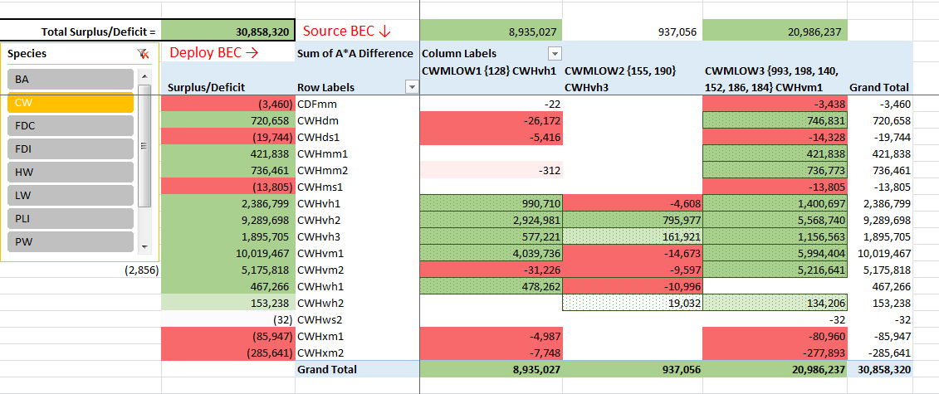
Gap Analysis – Cw Surplus and Deficits (CBST)
Surplus-Deficit (trees) is based on SPAR Inventory minus Historical Planting by BEC variant Source: GIS-based spatial overlay
Green cells = Surplus
Red cells = Deficit
Notes:
SPEAKING NOTES:
So this third table is essentially the demand and the supply tables added together to show you the surpluses (colored green) and deficits (colored red).
A very important point with this table is that you can trade off between orchards seeds where there is overlap in deployment areas that use the same BEC varants.
This is something you can not see in the other Supply and Demand table for CBST – you don’t see where surpluses in one group might cover the deficits in another group. The other table may show surpluses – but it is more complicated – as those surpluses may be needed to cover off deficits in other areas.
Point out example of where a deficit in a red box can be covered by a surplus in a green box, resulting in an overall surplus (on the far left summary column).

Slide 44
Options to address deficits
In the transition period, use GBST transfer standards
Use A Class seed from the BEC variant with the highest genetic suitability match - POLICY OPTION
Use A Class seed from US (if it exists & is available)
A new Orchard with parents from drier and warmer BECvars (BC or US) could be established.
Infuse existing orchards with drier warmer parents.
Use B Class seed (BC or US)
Notes:
SPEAKING NOTES
Note I removed the ‘Cw ‘ from this slide – i think the options still work genericaly – but check to make sure they still make sense for the spp demo’d

Slide 45
Seed Supply Planning under CBST
Overlaps in deployment between interim planning units are substantive. Check specific deployment BECvars and inventory before considering collections.
Keep collections to 2 to 5 years supply at most – unless you know there is a longer term need.
Expect new or modified orchards in 5 to 10 years.

Slide 46
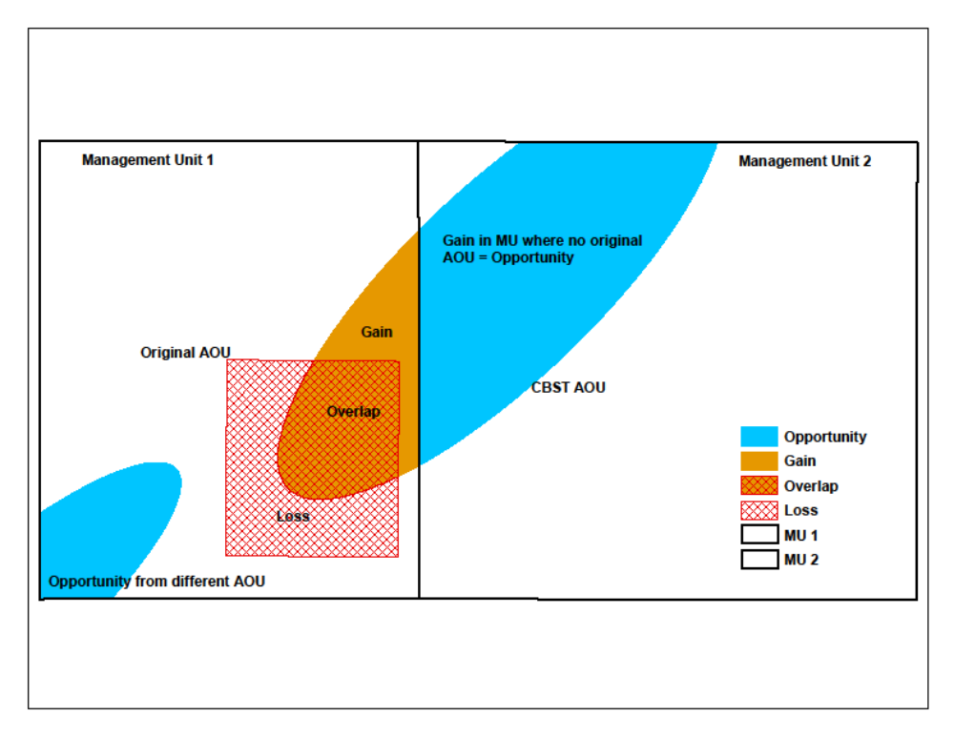
Schematic of Quantified Impact Analysis:
Notes:
SPEAKING NOTES:
One of the other tools that we have developed is useful for seeing which seedlots that you used previously in your management unit, can you still use, and which ones are moving out of your management unit.
This tool will also indicate which A Class seedlots may be now becoming available to use in your management unit.
This tool is based on area for BEC variants in your management unit
management units included are TSAs and TFLs so you do need to look at your own operating area within each management unit.

Slide 47
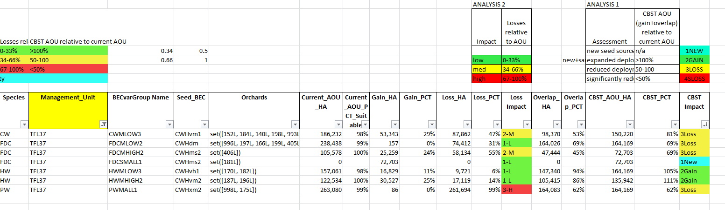
Impacts on TFL 37 (North Vanc Island), all species
A class seed only
Notes:
SPEAKING NOTES
This is an example of a TFL and all the species and BEC variants of A class seed that could be planted there previously and that can now be planted under CBST.
Most management units will have a mix of impacts – opportunities (in blue) and losses (in yellow and red)

Slide 48
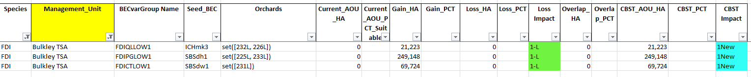
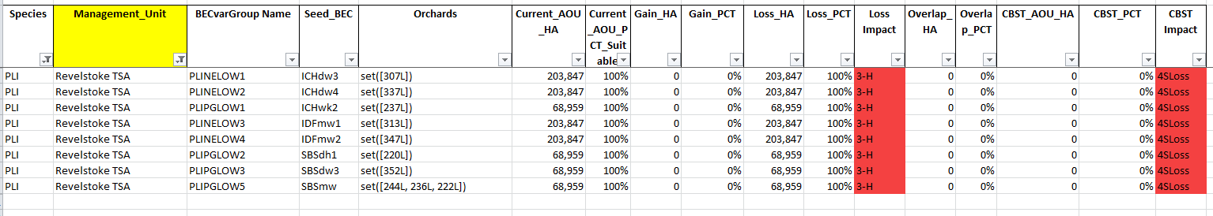
Impacts on Bulkley TSA - Fdi AOU opportunities!
A class seed only
Impacts on Revelstoke TSA - Pli AOU losses!
A class seed only
Notes:
SPEAKING NOTES
These are a couple of examples of TSAs where you have good news, or bad news.
Most of the good news stories are about A class seed moving to northern management units that haven’t previously had access to A class seed.
The tougher stories are in the south, especially along the southern border of BC in the Kootenays, where seed is moving out, but we still have to address what seed may be moving in from the US – who don’t use a BEC system.

Slide 49
Near Term Actions (now to 2 years)
Gap analysis and Impact assessment tools to be made available to all stakeholders / licensees
Broader stakeholder engagement on transition plans and selected policy development
Transition strategy and full implementation plan
Ongoing data and climate updates
Monitoring framework developed

Slide 50
Short Term Actions (2 to 5 years)
New “SPUs"/Breeding Zones defined
Amendments to Chief Foresters Standards to end transition period
Increased monitoring and evaluation
Additional research identified and initiated
Longer term Action (5+ years)
New Seed Orchards come on stream
Coordination with the Climate Informed Species Selection (CISS) Tool, led by RPB.

Slide 51
See, Ministry of Forests, Lands, Natural Resource Operations and Rural Development, Tree Seed and CBST webpages,
www.gov.bc.ca/climatebasedseedtransfer
Margot Spence, Seed Policy Officer/CBST project lead, Forest Improvement and Research Management Branch (Margot.Spence@gov.bc.ca)
Susan Zedel, Seed Resource Specialist, Forest Improvement and Research Management Branch (Susan.Zedel@gov.bc.ca)
Leslie McAuley, Decision Support Officer, forest Improvement and Research Management Branch (Leslie.Mcauley@gov.bc.ca)

